Slide 1

Mo Patel
Director, Artificial Intelligence
Think Big Analytics
Cynthia Li
Data Scientist
Think Big Analytics
Deep Learning for Recommender Systems
Strata Data Conference
New York 2017
Recommender Systems
Collaborative Filtering
Deep & Wide Learning
Deep Matrix Factorization

Slide 2
Agenda
11_89
Recommender Systems 101
Collaborative Filtering
Deep & Wide Learning
Deep Matrix Factorization

Slide 3
History of Recommendation
Human
DJ
Human + Data
Market Basket
Data + Machines
Matrix Factorization
Librarian
Sommelier
People you may know
Job you may be interested in
Items you may want to consider
Deep & Wide Learning
Deep Matrix Factorization

Slide 4

“
A family of methods that enable filtering through large observation and information space in order to provide recommendations in the information space [whether] that user does [or does] not have any observation, where the information space is all of the available items that the user could choose or select and observation space is what user experienced or observed so far.
’’
Bugra Akyildiz on Recommender Systems
https://bugra.github.io/work/notes/2014-04-19/alternating-least-squares-method-for-collaborative-filtering/

Slide 5

Recommender Systems Impact
2/3 of the movies watched are recommended
Recommendations generate 38% more click through
70% of Amazon home page is devoted to Recommendations
It's scary how well Spotify Discover Weekly playlists know me.
@Dave_Horwitz
Recommender Systems (Machine Learning Summer School 2014 @ CMU
https://www.slideshare.net/xamat/recommender-systems-machine-learning-summer-school-2014-cmu
Amazon: https://www.monetate.com/infographic/maximize-online-sales-with-product-recommendations

Slide 6
Traditional recommendation approaches
Collect data -> explicit/implicit/hybrid feedback
Learn Rules
Wine & Cheese
Beer & Diapers
Filtering
Content based
Collaborative
Hybrid
Notes:
Recommender systems are information filtering systems that deal with the problem of information overload filtering vital information fragment out of large amounts of dynami- cally generated information according to user’s preferences, interest, or observed behavior. Recommender systems aim for the ability to predict whether a particular user would prefer an item or not based on the user’s profile.
Recommender systems are defined as a means of assisting and augmenting the social process of using recommendations from others to make choices when there is not sufficient personal knowledge nor experiece of the alternatives. Personalized, user-specific exclusive content and service recommendations are the result.

Slide 7
Traditional recommendation approaches
Collect data -> explicit/implicit/hybrid feedback
information collection phase
learning phase
prediction/
recommendation
phase
Recommendation phases
Notes:
Traditional recommendation systems require collection of data from the outset. Relevant informant from users is needed to generate a user profile or model for prediction. The system needs to know as much as possible from the user in order to provide reasonable recommendations as soon as possible. Obviously, accurate models indispensable for creating relevant and accurate recommendations.
Explicit feedback comes directly form the user. Traditional approaches normally prompt users through a system interface to provide ratings of items in order to construct and improve the users’ model. The quality of the users’ input determines the accuracy of the model. The main shortcoming of this approach is it requires effort on the part of the user.
Implicit feedback can ben inferred by tracking users’ preferences by monitoring different actions such as purchase history, navigation history, time spent on web pages, links followed, email content and button clicks. Inferred from user behavior, implicit feedback data might be more objective that explicit feedback.
The strengths of both implicit and explicit feedback can be combined in a hybrid system in order to minimize their weaknesses and get a better performing system. This can be achieved by using an implicit data as a check on explicit rating or allowing users to give explicit feedback only when the user chooses to do so.

Slide 8
Traditional recommendation approaches
Learning phase -> prediction recommendation
source: Recommendation systems: Principles, methods and evaluation
Notes:
The Learning Phase implies a learning algorithm to filter and exploit the user’s features from the feedback gathered. The algo recommends or predcts what kind of items the user may prefer. This directly based on history or model, or indirectly based on the observed activities of the user. The use of efficient and accurate recommendation techniques is very important for a system that will provide good recommendation to its individual users. This explains the importance of understanding the features and potentials of different recommendation techniques. This image shows the anatomy of different recommendation filtering techniques.

Slide 9
Traditional recommendation approaches
Filtering
Content based
Collaborative
Hybrid
Notes:
Content-based technique is a domain-dependent algorithm and it emphasizes more on the analysis of the attributes of items in order to generate predictions. When documents such as web pages, publications and news are to be recommended, content-based filtering technique is the most successful. In content-based filtering technique, recommendation is made based on the user profiles using features extracted from the content of the items the user has evaluated in the past . Items that are mostly related to the positively rated items are recommended to the user. CBF uses different types of models to find similarity between documents in order to generate meaningful recommendations. It could use Vector Space Model such as Term Frequency Inverse Document Frequency (TF/IDF) or Probabilistic models such as Naı ̈ve Bayes Classifier, Decision Trees or Neural Networks to model the relationship between different documents within a corpus. These techniques make recommendations by learning the underlying model with either statistical analysis or machine learning techniques. Content-based filtering tech- nique does not need the profile of other users since they do not influence recommendation. Also, if the user profile changes, CBF technique still has the potential to adjust its rec- ommendations within a very short period of time. The major disadvantage of this technique is the need to have an in- depth knowledge and description of the features of the items in the profile.
Collaborative filtering is a domain-independent prediction technique for content that cannot easily and adequately be described by metadata such as movies and music. Collaborative filtering technique works by building a database (user-item matrix) of preferences for items by users. It then matches users with relevant interest and preferences by calcu- lating similarities between their profiles to make recommenda- tions. Such users build a group called neighborhood. An user gets recommendations to those items that he has not rated before but that were already positively rated by users in his neighborhood. Recommendations that are produced by CF can be of either prediction or recommendation. Prediction is a numerical value, Rij, expressing the predicted score of item j for the user i, while Recommendation is a list of top N items that the user will like the most.. The technique of collaborative filtering can be divided into two cate- gories: memory-based and model-based.
Hybrid filtering technique combines different recommendation techniques in order to gain better system optimization to avoid some limitations and problems of pure recommendation sys- tems. The idea behind hybrid techniques is that a com- bination of algorithms will provide more accurate and effective recommendations than a single algorithm as the disadvantages of one algorithm can be overcome by another algorithm

Slide 10
Collaborative Filtering
A variety of approaches
Inherently difficult to evaluate
Notes:
In recent years some of the more successful technologies for recommender systems are the collaborative filtering types. A number of different algorithmic approaches exist. Each algorithmic approach has adherents who claim it to be superior for some purpose. Clearly identifying the best algorithm for a given purpose has proven challenging, in part because researchers disagree on which attributes should be measured, and on which metrics should be used for each attribute. Re- searchers who survey the literature will find over a dozen quantitative metrics and additional qualitative evaluation techniques.
Evaluating recommender systems and their algorithms is inherently difficult for several reasons. First, different algorithms may be better or worse on different data sets. Many collaborative filtering algorithms have been designed specifically for data sets where there are many more users than items (e.g., the MovieLens data set has 65,000 users and 5,000 movies). Such algorithms may be entirely inappropriate in a domain where there are many more items than users (e.g., a research paper recommender with thousands of users but tens or hundreds of thousands of articles to recommend). Similar differences exist for ratings density, ratings scale, and other properties of data sets.
The second reason that evaluation is difficult is that the goals for which an evaluation is performed may differ. Much early evaluation work focused specifically on the “accuracy” of collaborative filtering algorithms in “predict- ing” withheld ratings. Even early researchers recognized, however, that when recommenders are used to support decisions, it can be more valuable to measure how often the system leads its users to wrong choices.

Slide 11
Collaborative Filtering
Intuitively:
Personal tastes correlate for a given domain and information space.
Users who agreed before are more likely to agree in future on some particular item.
To approximate the rating of the user, we select users who have somehow similar taste.
Notes:
By way of definition, let us stipulate that collaborative Filtering(CF) is a subset of algorithms that exploit other users and items along with their ratings(selection, purchase information could be also used) and target user history to recommend an item that target user does not have ratings for. Fundamental assumption behind this approach is that other users preference over the items could be used recommending an item to the user who did not see the item or purchase before. CF differs itself from content-based methods in the sense that user or the item itself does not play a role in recommendation but rather how(rating) and which rated a particular item. (Preference of users is shared through a group of users who selected, purchased or rate items similarly)

Slide 12
Collaborative Filtering
Advantages over content based methods
No need to know about item content
Content of the item does not necessarily tell the whole story. What features(length, category, actor/actresses) of movie of an item is important for a particular user? No information is necessary for CF.
"Item cold-start" problem is avoided
When the item information is not available, we do not need it as long as some users purchased the item.

Slide 13
Collaborative Filtering
Advantages over content based methods
No need to know about item content
Content of the item does not necessarily tell the whole story. What features(length, category, actor/actresses) of movie of an item is important for a particular user? No information is necessary for CF.
"Item cold-start" problem is avoided
When the item information is not available, we do not need it as long as some users purchased the item.
Cold start is a potential problem in computer-based information systems which involve a degree of automated data modelling. Specifically, it concerns the issue that the system cannot draw any inferences for users or items about which it has not yet gathered sufficient information.

Slide 14
Collaborative Filtering
Advantages over content based methods
User interest may change over time.
Focusing on content solely does not provide any flexibility on the user side. We need to take the user preference change into consideration as well.
Explainability
Rather than rely on content, plausible social rationale for the user can result (eg: "You will like this product because other users like you like the product”).
Capture subtlety
This is generally true for latent factor models. If most of the users are buying two unrelated items, then it is likely another user who shares the same taste of the larger set of users is likely to buy that unrelated thing, which brings serendipity to the table.
Notes:
By way of definition, let us stipulate that collaborative Filtering(CF) is a subset of algorithms that exploit other users and items along with their ratings(selection, purchase information could be also used) and target user history to recommend an item that target user does not have ratings for. Fundamental assumption behind this approach is that other users preference over the items could be used recommending an item to the user who did not see the item or purchase before. CF differs itself from content-based methods in the sense that user or the item itself does not play a role in recommendation but rather how(rating) and which rated a particular item. (Preference of users is shared through a group of users who selected, purchased or rate items similarly)

Slide 15
Agenda
11_89
Recommender Systems 101
Collaborative Filtering
Deep & Wide Learning
Deep Matrix Factorization

Slide 16
Collaborative Filtering
Disadvantages vs content based methods
Sparsity of user preference and Scalability in computation
User preference sparsity makes it hard to find users who share similar taste
Large sparse matrices make hard to do computation in general.
Privacy Concerns
Some users may not want their preference and taste available on the website even in an implicit form.
Synonym issue needs to be handled properly and normalized
Film-movie corresponds to the same thing, if one user buys comedy and the other buys "funny movies", they should be treated as same in order to improve both recommendations and not separate the things that are inherently alike.
Notes:
By way of definition, let us stipulate that collaborative Filtering(CF) is a subset of algorithms that exploit other users and items along with their ratings(selection, purchase information could be also used) and target user history to recommend an item that target user does not have ratings for. Fundamental assumption behind this approach is that other users preference over the items could be used recommending an item to the user who did not see the item or purchase before. CF differs itself from content-based methods in the sense that user or the item itself does not play a role in recommendation but rather how(rating) and which rated a particular item. (Preference of users is shared through a group of users who selected, purchased or rate items similarly)

Slide 17
Collaborative Filtering
Disadvantages vs content based methods
Gray Sheep
There may be people whose taste and preference do not consistently agree with other users' preference. Recommendations for these users may not make sense as their taste is quite distinct from others.
Shilling Attack
People who like one brand may give consistently high scores to that brand and give poor scores to the competitors no matter what their real experience are.
Notes:
By way of definition, let us stipulate that collaborative Filtering(CF) is a subset of algorithms that exploit other users and items along with their ratings(selection, purchase information could be also used) and target user history to recommend an item that target user does not have ratings for. Fundamental assumption behind this approach is that other users preference over the items could be used recommending an item to the user who did not see the item or purchase before. CF differs itself from content-based methods in the sense that user or the item itself does not play a role in recommendation but rather how(rating) and which rated a particular item. (Preference of users is shared through a group of users who selected, purchased or rate items similarly)

Slide 18
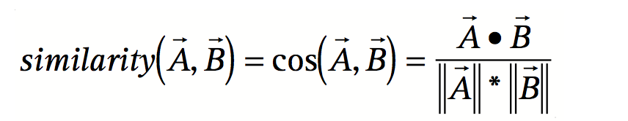
Amazon Recommendations
Three common approaches:
Traditional Collaborative Filtering
Cluster models
Search-based methods
Notes:
Most recommendation algorithms start by finding a set of customers whose purchased and rated items overlap the user’s purchased and rated items. The algorithm aggregates items from these similar customers, eliminates items the user has already purchased or rated, and recommends the remaining items to the user. Two popular versions of these algorithms are collaborative filtering and cluster models. Other algorithms — including search-based methods and our own item-to-item collaborative filtering — focus on finding similar items, not similar customers. For each of the user’s purchased and rated items, the algorithm attempts to find similar items. It then aggregates the similar items and recommends them.
A traditional collaborative filtering algorithm represents a customer as an N-dimensional vector of items, where N is the number of distinct catalog items. The components of the vector are positive for purchased or positively rated items and negative for negatively rated items. To compensate for best-selling items, the algorithm typically multi- plies the vector components by the inverse frequency (the inverse of the number of customers who have purchased or rated the item), making less well-known items much more relevant. For almost all customers, this vector is extremely sparse.
The algorithm generates recommendations based on a few customers who are most similar to the user. It can measure the similarity of two customers, A and B, in various ways; a common method is to measure the cosine of the angle between the two vectors.
The algorithm can select recommendations from the similar customers’ items using various methods as well, a common technique is to rank each item according to how many similar customers purchased it.

Slide 19
Amazon Recommendations
Traditional Collaborative Filtering is computationally expensive:
M = number of customers, N = number of catalog items
Worst case: O^{(MN)}
Generally: O^{(M+N)}
Notes:
Using collaborative filtering to generate recommendations is computationally expensive. It is O(MN) in the worst case, where M is the number of customers and N is the number of product catalog items, since it examines M customers and up to N items for each customer. However, because the average customer vector is extremely sparse, the algorithm’s performance tends to be closer to O(M + N). Scanning every customer is approximately O(M), not O(MN), because almost all customer vectors contain a small number of items, regardless of the size of the catalog. But there are a few customers who have purchased or rated a significant percentage of the catalog, requiring O(N) processing time. Thus, the final performance of the algorithm is approximately O(M + N). Even so, for very large data sets — such as 10 million or more customers and 1 million or more catalog items — the algorithm encounters severe performance and scaling issues.
It is possible to partially address these scaling issues by reducing the data size. We can reduce M by randomly sampling the customers or discarding customers with few purchases, and reduce N by dis- carding very popular or unpopular items. It is also possible to reduce the number of items examined by a small, constant factor by partitioning the item space based on product category or subject classification. Dimensionality reduction techniques such as clustering and principal component analysis can reduce M or N by a large factor.
Unfortunately, all these methods also reduce recommendation quality in several ways. First, if the algorithm examines only a small customer sample, the selected customers will be less similar to the user. Second, item-space partitioning restricts recommendations to a specific product or subject area. Third, if the algorithm discards the most popular or unpopular items, they will never appear as recommendations, and customers who have purchased only those items will not get recommendations. Dimensionality reduction techniques applied to the item space tend to have the same effect by eliminating low-frequency items. Dimensionality reduction applied to the customer space effectively groups similar customers into clusters; as we now describe, such clustering can also degrade recommendation quality.

Slide 20
ALS Method for Collaborative Filtering
Co-clustering
Notes:
Let’s take a step back and recognize the inherent problem we have is one of co-clustering. Our data is bimodal at the very least. And our clustering is fuzzy by definition – each observation can belong to one or more clusters. Where classical clustering methods assume that a membership of an object (in a group of objects) depends solely on its similarity to other objects of the same type (same entity type), co-clustering can be seen as a method of co-grouping two types of entities simultaneously, based on similarity of their pairwise interactions.
Co-clustering matrices in our recommender use cases can be explained as grouping both similar users and similar documents into, let’s say, categories or interests, synchronously.
Co-clustering is extremely useful when the pairwise interactions signal is sparse. And again, it is easier to demonstrate with an example: consider the case of internet users reading news articles. Now think of two users with similar affinity to the same news categories. Even if the two match perfectly in their preferences, it is extremely unlikely that the two will read exactly the same articles, due to the huge variety of news articles offered daily on the net. Moreover, it is even fair to assume that the amount of articles read by both users is very low. In this case, clustering similar users based on the articles they read (or on the opposite side, clustering articles based on overlapping readers) seems pretty useless. And it is the case where co-clustering approach really shines, comparing to “regular” unimodal clustering.

Slide 21
ALS Method for Collaborative Filtering
Co-clustering
Matrix Factorization
Notes:
One of the most popular algorithms to solve co-clustering problems (and specifically for collaborative recommender systems) is called Matrix Factorization (MF). In its simplest form, it assumes a matrix of ratings given by m users to n items. Applying this technique on R will end up factorizing R into two matrices and such that (their multiplication approximates R).
Note that this algorithm introduces a new quantity, k, that serves as both U‘s and P‘s dimensions. This is the rank of the factorization. Formally, each is factorized into the dot product of Ui . Pj. Intuitively, this model assumes every rating in R is affected by k effects. Moreover, it represents both users and items in U and P accordingly, in terms of those k effects.
So, assuming R is a matrix of users rating movies, it is pretty straightforward to assume that each movie is tied to one or more categories with some strength, each user likes/dislikes some movie-categories with different strengths, and the rating that a user should have given a movie depended on the similarity between his characteristics and this movie’s characteristics. The problem is, how to form those categories efficiently. It might even depend of certain affinity to some movie actors, directors, language, location of filming, and more, and the number of possible features to create is immense.

Slide 22
ALS Method for Collaborative Filtering
Co-clustering
Matrix Factorization
Notes:
Actually, we are back to the co-clustering problem where we have pairwise interactions between two entities (a user and a movie), that eventually can incorporate a rating matrix that is quite sparse (due high variety of movies, for example, users will be able to rate only a small fraction of them). Intuitively, we can represent users (or movies) by their affinity (or connection) to categories/actors/languages or any other factors, and finally try to cluster them based on this representation. The problem is, it is quite hard to quantify the effect of each such factor on the original ratings. Moreover, there might be factors that are inherent to the rating process, but are missed from our new representations.
So back to linear algebra, MF is a form of optimization process that aims to approximate the original matrix R with the two matrices U and P, such that it minimizes the cost function.
The first term in this cost function is the Mean Square Error (MSE) distance measure between the original rating matrix R and its approximation . The second term is called a “regularization term” and is added to govern a generalized solution (to prevent overfitting to some local noisy effects on ratings).
This optimization problem is naturally solved by machine learning techniques. But first, note that this cost function introduces two parameters: k and lambda. Apart from trying to produce a minimal value of this cost function for a givent k and , it is essential to determine what is the optimal values of those parameters. In the rest of this chapter, I will go over two optimization process that are used to have this cost function converged to minimum, given k and lamda . Bear in mind that some higher level optimization process (such as Cross Validation) can be incorporated to insure a good selection of those parameters.

Slide 23
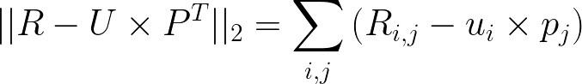
ALS Method for Collaborative Filtering
Co-clustering
Matrix Factorization
Alternating Least Squares
Notes:
Looking again at MF’s cost function, it appears that we aim at learning two types of variables – those of U and those of P, and the two types are tied in the multiplication of U x P. Recall that the actual cost function is the summation as shown plus regularization term. The fact that both U’s and P’s values are unknown variables makes this cost function non-convex.

Slide 24
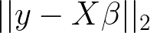
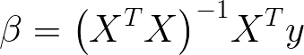
ALS Method for Collaborative Filtering
Co-clustering
Matrix Factorization
Alternating Least Squares
Solve for by minimizing square errors:
Ordinary Least Squares:
Notes:
But another interesting fact lies in this term – if we fix P and optimize for U alone, the problem is simply reduced to the problem of linear regression. Recall that in linear regression we solve for by minimizing the squared error given X and y. The solution is ultimately given by the Ordinary Least Squares (OLS) formula .
Alternating least squares does just that. It is a two-step iterative optimization process. In every iteration it first fixes P and solves for U, and following that it fixes U and solves for P. Since OLS solution is unique and guarantees a minimal MSE, in each step the cost function can either decrease or stay unchanged, but never increase. Alternating between the two steps guarantees reduction of the cost function, until convergence. Similarly to gradient descent optimization, it is guaranteed to converge only to a local minima, and is ultimately depends on initial values for U or P.

Slide 25
ALS Method for Collaborative Filtering
Co-clustering
Matrix Factorization
Alternating Least Squares
Notes:
Since the actual cost function includes a regularization term, it is slightly longer. According to the two-step process, the cost function can be broken down into two cost functions.

Slide 26
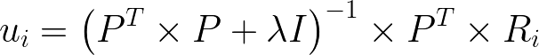
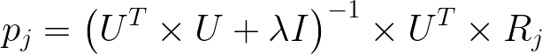
ALS Method for Collaborative Filtering
Co-clustering
Matrix Factorization
Alternating Least Squares
Notes:
And the matching solutions for u(i) and p(j) are here.
And since each doesn’t depend on other vectors, each step can potentially be introduced to massive parallelization.

Slide 27
Matrix Factorization Notebook
Demonstrate how to use the TensorFlow API to implement a matrix factorization model (ALS)

Slide 28
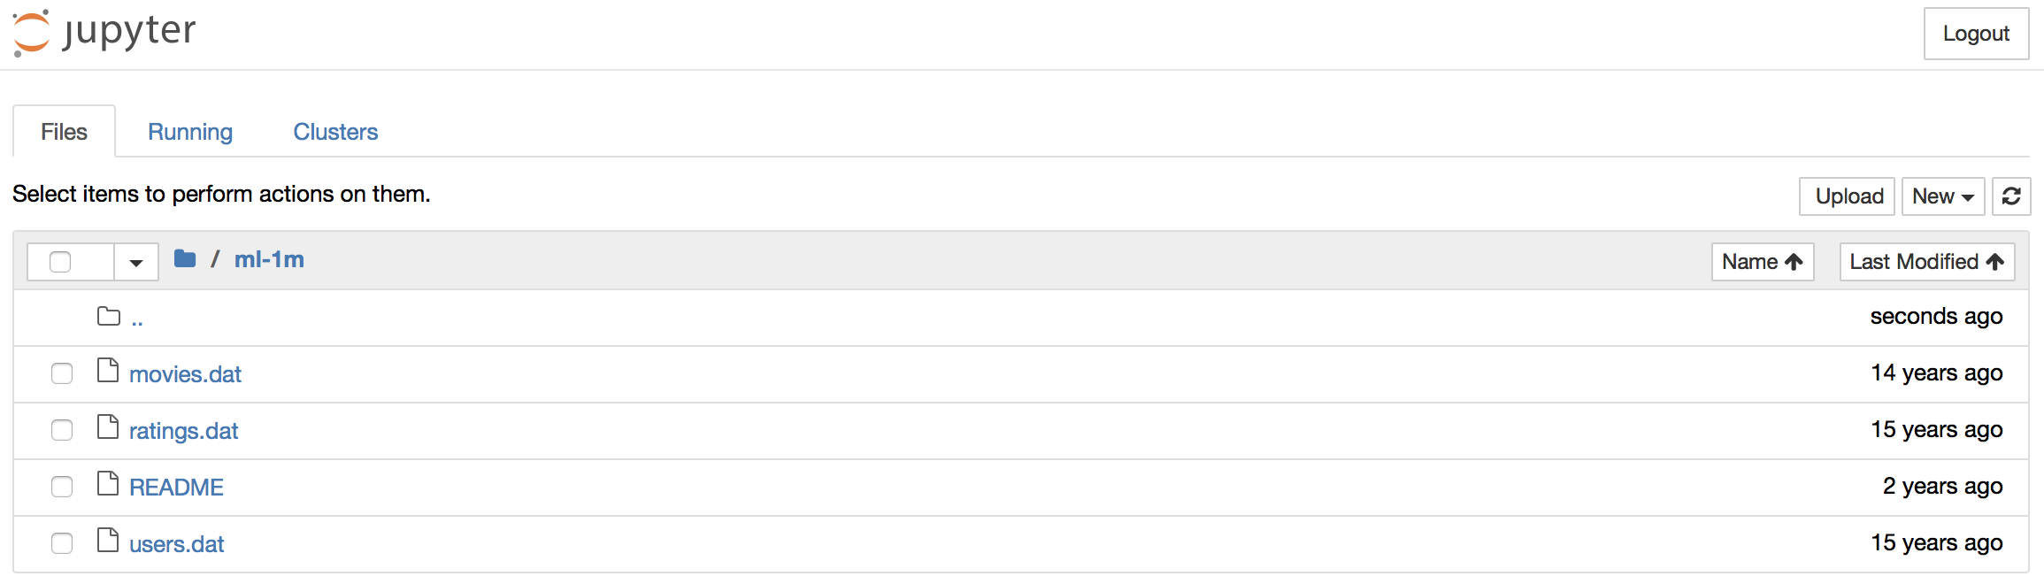
Our Dataset
Our dataset: Movielens 1m dataset
http://files.grouplens.org/datasets/movielens/ml-1m.zip
Notes:
Recall that the wide component is a generalized linear model of the form y = w^T x + b, as illustrated above (left).
One of the most important transformations is the cross-product transformation, which we saw earlier.It it defined here, where c-ki is a boolean variable that is 1 if the ith feature is part of the k-th transformation k, and 0 otherwise.For binary features, a cross-product transformation (e.g., “AND(gender=female, language=en)”) is 1 if and only if the constituent features (“gender=female” and “language=en”) are all 1, and 0 otherwise. This captures the interactions between the binary features, and adds nonlinearity to the generalized linear model.

Slide 29
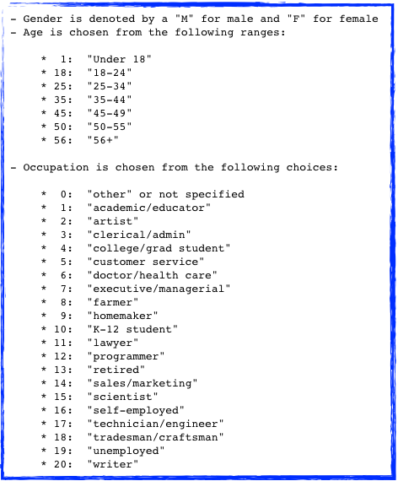

Our Dataset
movies.dat
1::Toy Story (1995)::Animation|Children's|Comedy
2::Jumanji (1995)::Adventure|Children's|Fantasy
3::Grumpier Old Men (1995)::Comedy|Romance
4::Waiting to Exhale (1995)::Comedy|Drama
5::Father of the Bride Part II (1995)::Comedy
users.dat
1::F::1::10::48067
2::M::56::16::70072
3::M::25::15::55117
4::M::45::7::02460
ratings.dat
1::1193::5::978300760
1::661::3::978302109
1::914::3::978301968
1::3408::4::978300275
Columns are separated by ::

Slide 30
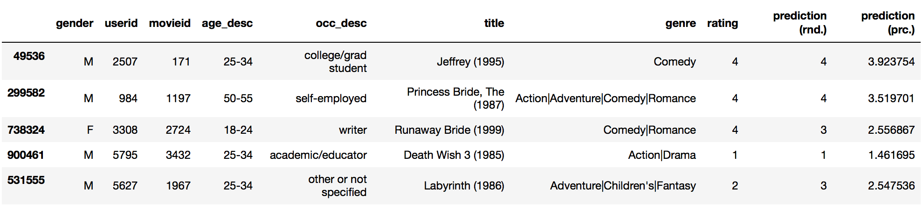
The Goal
Our Goal is to predict the rating for a given pair of user id and movie id
MF Accuracy: 45.008881%

Slide 31
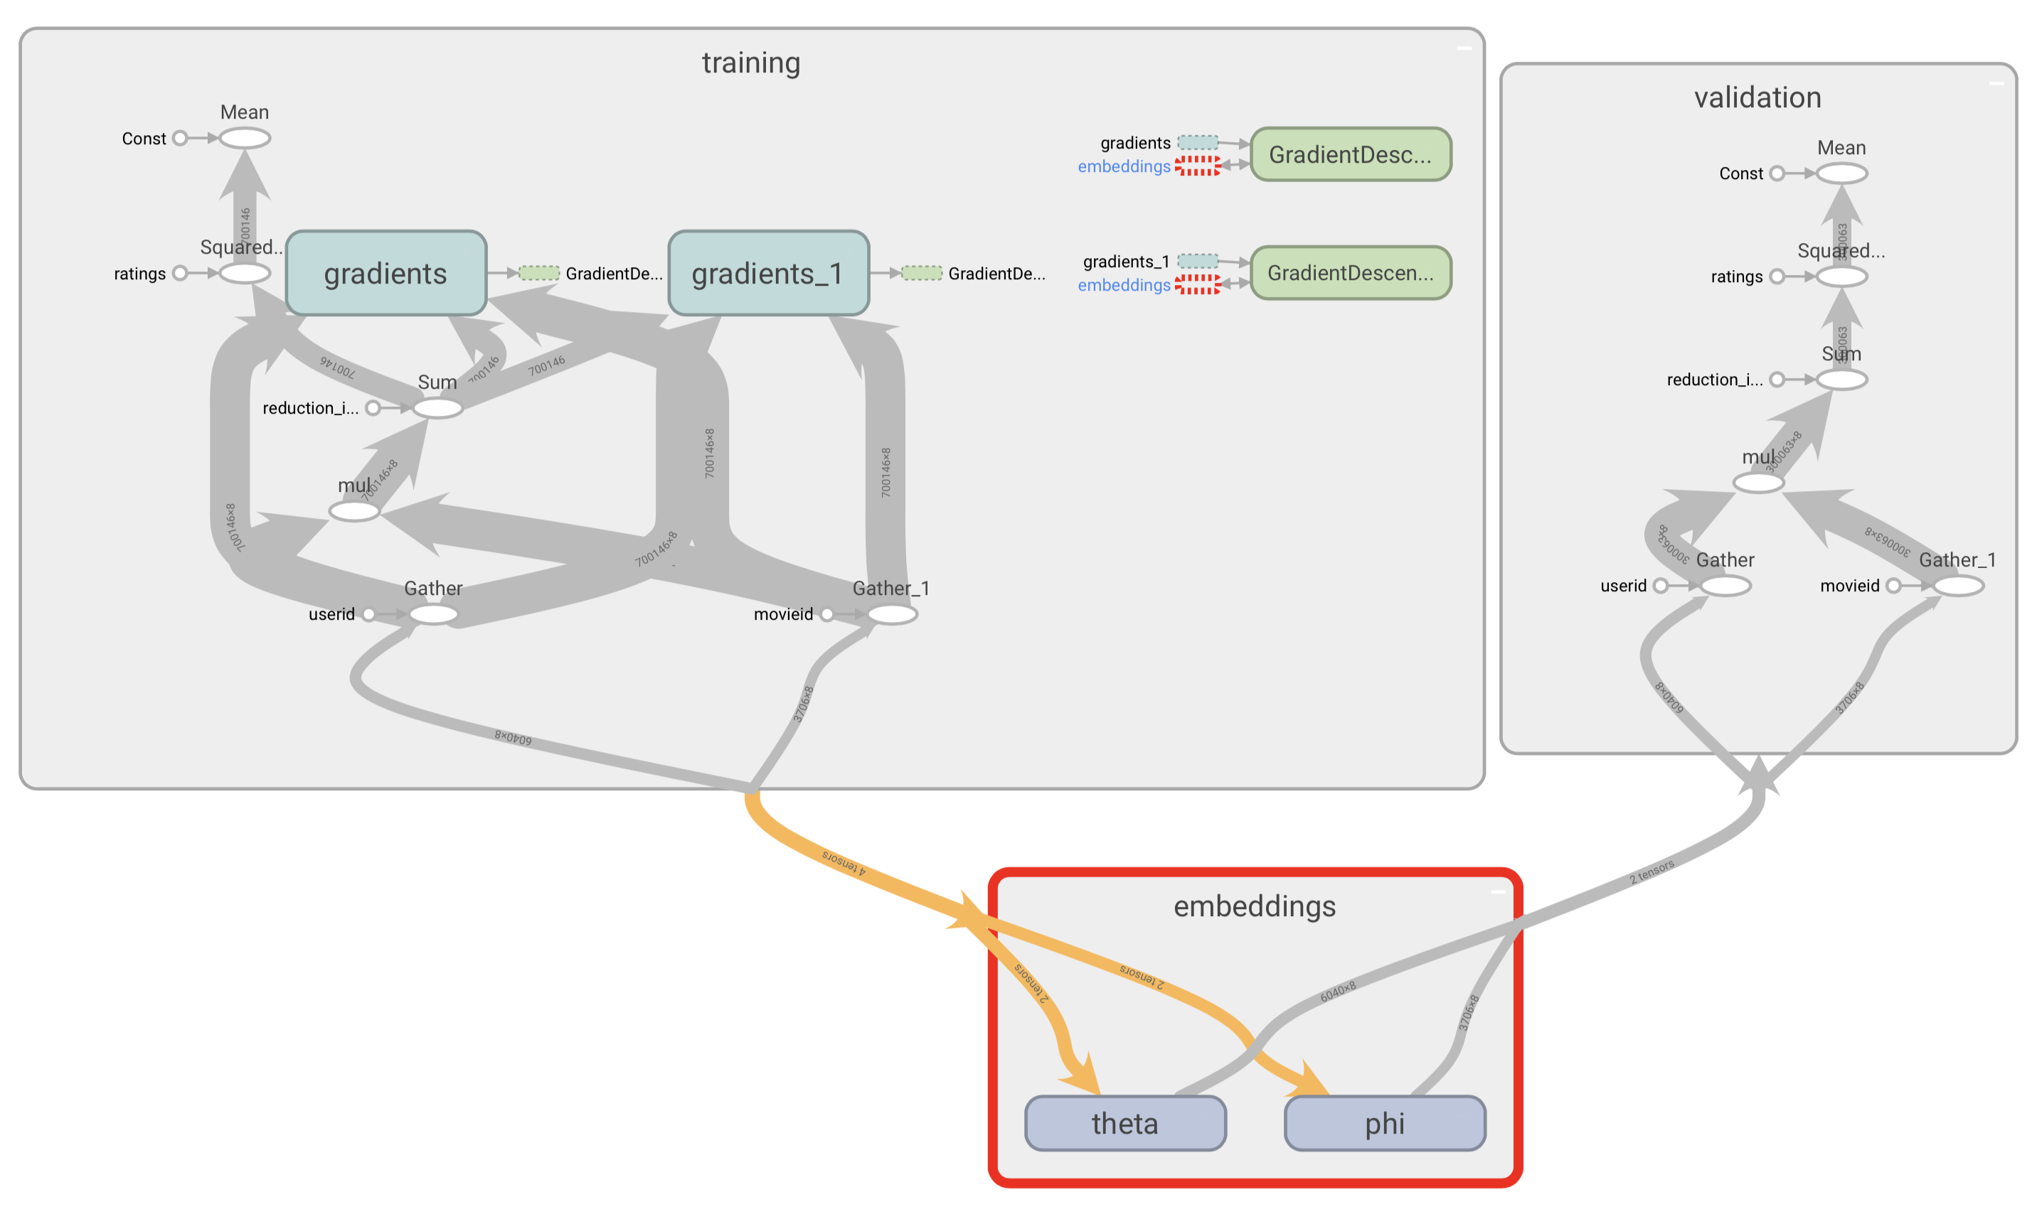
Implementation Steps
Load data
Set up our parameters: θ and ϕ
Define non-trainable variables: user ids, movie ids and ratings
Calculate the prediction and cost
Train and evaluate the model
tensorboard --logdir=path/to/log-directory

Slide 32
Agenda
11_89
Recommender Systems 101
Collaborative Filtering
Deep & Wide Learning
Deep Matrix Factorization

Slide 33
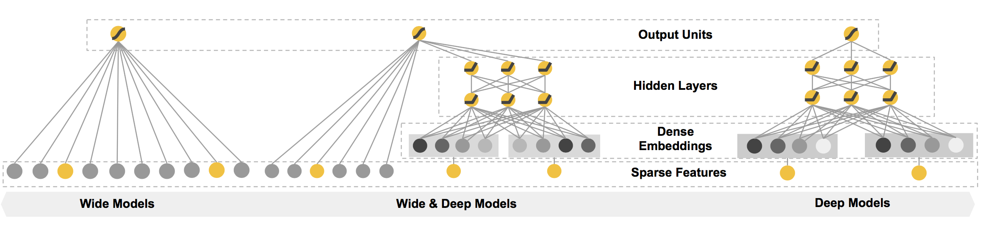
Wide & Deep
Notes:
Based on Google’s work and Open Sourcing of TensorFlow, the Wide & Deep learning framework for jointly training feed-forward neural networks with embeddings and linear model with feature transformations for generic recommender systems with sparse inputs is depicted here.
While the idea is relatively simple, Wide & Deep has demonstrated significant improvements over previous approaches.

Slide 34
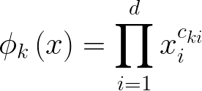
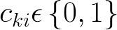
Wide & Deep
Notes:
The wide component is a generalized linear model of the form y = w^T x + b, as illustrated above (left). y is the prediction, x = [x1, x2, ..., xd] is a vector of d features, w = [w1,w2,...,wd] are the model parameters and b is the bias. The feature set includes raw input features and transformed features. One of the most important transformations is the cross-product transformation, which is defined as above, where Cki is a boolean variable that is 1 if the i-th feature is part of the k-th transformation Phi(k) and 0 otherwise. For binary features, a cross-product transformation (e.g., “AND(gender=female, language=en)”) is 1 if and only if the constituent features (“gender=female” and “language=en”) are all 1, and 0 otherwise. This captures the interactions between the binary features, and adds nonlinearity to the generalized linear model.

Slide 35
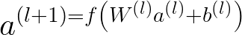
Wide & Deep
Notes:
The deep component is a feed-forward neural network, as shown on the right. For categorical features, the original inputs are feature strings (e.g., “language=en”). Each of these sparse, high-dimensional categorical features are first converted into a low-dimensional and dense real-valued vector, often referred to as an embedding vector. The dimensionality of the embeddings are usually on the order of O(10) to O(100). The embedding vectors are initialized randomly and then the values are trained to minimize the final loss function during model training. These low-dimensional dense embedding vectors are then fed into the hidden layers of a neural network in the forward pass. Specifically, each hidden layer performs the computation depicted,
where l is the layer number and f is the activation function, often rectified linear units (ReLUs). a(l) , b(l) , and W (l) are the activations, bias, and model weights at l-th layer.

Slide 36
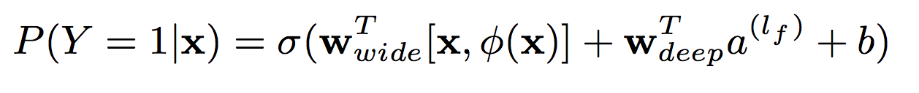
Wide & Deep
Notes:
The wide component and deep component are combined using a weighted sum of their output log odds as the prediction, which is then fed to one common logistic loss function for joint training. Note that there is a distinction between joint training and ensemble. In an ensemble, individual models are trained separately without knowing each other, and their predictions are combined only at inference time but not at training time. In contrast, joint training optimizes all parameters simultaneously by taking both the wide and deep part as well as the weights of their sum into account at training time. There are implications on model size too: For an ensemble, since the training is disjoint, each individual model size usually needs to be larger (e.g., with more features and transformations) to achieve reasonable accuracy for an ensemble to work. In comparison, for joint training the wide part only needs to complement the weak- nesses of the deep part with a small number of cross-product feature transformations, rather than a full-size wide model.
Joint training of a Wide & Deep Model is done by back- propagating the gradients from the output to both the wide and deep part of the model simultaneously using mini-batch stochastic optimization. In the experiments conducted by Google, a Follow- the-regularized-leader (FTRL) algorithm with L1 regularization as the optimizer for the wide part of the model, and AdaGrad] for the deep part.
The combined model is illustrated in the center. For a logistic regression problem, the model’s prediction (depicted) where Y is the binary class label, σ(·) is the sigmoid function, φ(x) are the cross product transformations of the original features x, and b is the bias term. Wwide is the vector of all wide model weights, and Wdeep are the weights applied on the final activations a^(lf ).
The implementation of initial Wide & Deep app recommendations pipeline consisted of three stages: data generation, model training, and model service as show above.

Slide 37
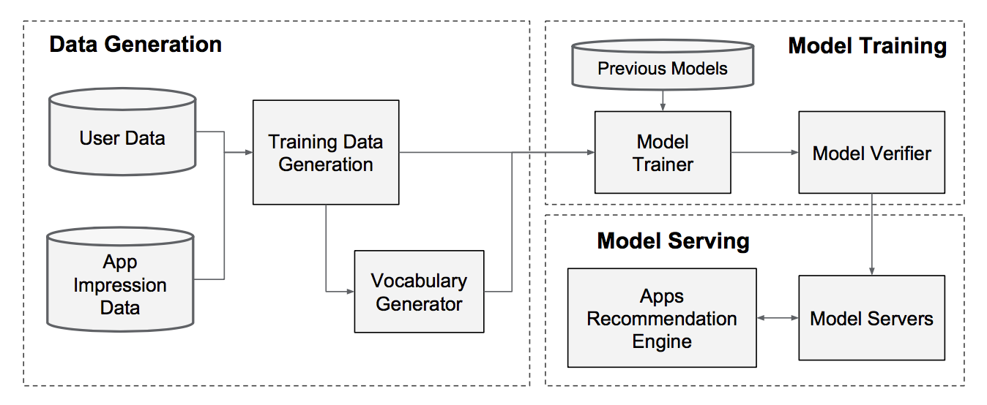
Wide & Deep
Notes:
The implementation of Google’s initial Wide & Deep app recommendations pipeline consisted of three stages: data generation, model training, and model service as show above.

Slide 38
Wide & Deep
Notes:
In the Data Generation stage, user and app impression data within a period of time are used to generate training data. Each example corresponds to one impression. The label is app acquisition: 1 if the impressed app was installed, and 0 otherwise.
Vocabularies, which are tables mapping categorical feature strings to integer IDs, are also generated in this stage. The system computes the ID space for all the string features that occurred more than a minimum number of times. Con- tinuous real-valued features are normalized to [0, 1] by map- ping a feature value x to its cumulative distribution function P (X ≤ x), divided into n(sub)q quantiles. The normalized value is i−1 / n(sub)q for values in the i-th quantiles. Quantile boundaries are computed during data generation.

Slide 39
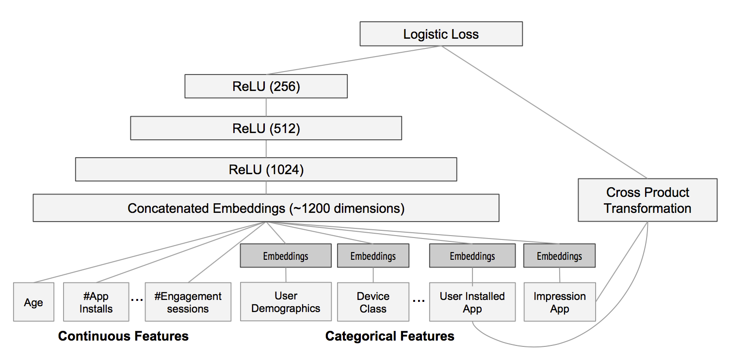
Wide & Deep
Notes:
The model structure used in the experiment is shown. During training, the input layer takes in training data and vocabularies and generate sparse and dense features together with a label. The wide component consists of the cross-product transformation of user installed apps and impression apps. For the deep part of the model, A 32- dimensional embedding vector is learned for each categorical feature.

Slide 40
Wide & Deep
Notes:
The Google team then concatenated all the embeddings together with the dense features, resulting in a dense vector of approximately 1200 dimensions. The concatenated vector is then fed into 3 ReLU layers, and finally the logistic output unit.
The Wide & Deep models are trained on over 500 billion examples. Every time a new set of training data arrives, the model needs to be re-trained. However, retraining from scratch every time is computationally expensive and delays the time from data arrival to serving an updated model. To tackle this challenge, they implemented a warm-starting system which initializes a new model with the embeddings and the linear model weights from the previous model.
Before loading the models into the model servers, a dry run of the model was done to make sure that it did not cause problems in serving live traffic. They then empirically validate the model quality against the previous model as a sanity check.

Slide 41
Wide & Deep
Notes:
Once the model is trained and verified, they load it into the model servers. For each request, the servers receive a set of app candidates from the app retrieval system and user features to score each app. Then, the apps are ranked from the highest scores to the lowest, and they show the apps to the users in that order. The scores were calculated by running a forward inference pass over the Wide & Deep model.
In order to serve each request on the order of 10 ms, they optimized the performance using multithreading parallelism by running smaller batches in parallel, instead of scoring all candidate apps in a single batch inference step.

Slide 42
Deep and Wide Notebook
Demonstrate how to use the tf.esimator API to train a wide linear model and a deep feed-forward neural network.

Slide 43
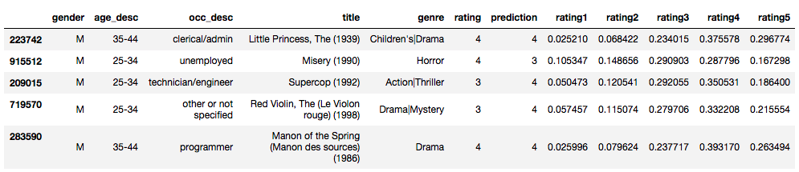
The Goal
Our Goal is to predict the rating category for a given pair of user id and movie id
DnW Accuracy: 34.907003%

Slide 44
Implementation Steps
Data preprocessing
Build inputs
Hash categorical features
Create embeddings of sparse features for the deep model
Define features for both the deep and the wide part of the model
Train and validate the model
Big chunk !
Preparing the inputs
model = tf.contrib.learn.DNNLinearCombinedClassifier(…...
)

Slide 45
Agenda
11_89
Recommender Systems 101
Collaborative Filtering
Deep & Wide Learning
Deep Matrix Factorization

Slide 46
Agenda
11_89
Recommender Systems 101
Collaborative Filtering
Deep & Wide Learning
Deep Matrix Factorization

Slide 47
Deep Matrix Factorization Notebook
Demonstrate how to use the tensorflow lower API to build a DNN model from scratch.
Notes:
With the inspiration of DnW, can we build a DNN that can improve the performance of traditional mf?

Slide 48
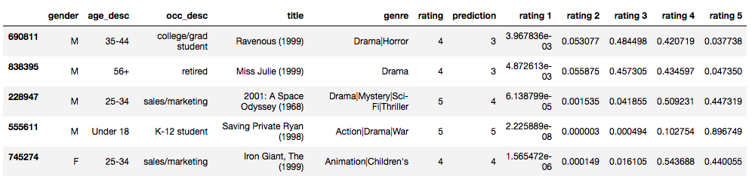
The Goal
Our Goal is not only to get a single prediction value, but also to know the probability distribution of the prediction.
DNN Accuracy: 50.559383%

Slide 49


The Advantage
With this additional probability information we can assess the risks and certainty of our result.
Notes:
The two graphs on the left shows positive indicator for recommendation.
Take the first one for example, true rating is 5, our prediction is 5. We know that the movie is highly likely to be rated 5, also has possibility to be rated 4. But it will absolutely not be rated 1 or 2. So we could be quite certain to recommend this movie to this user.
The 2nd one, even though we predicted wrong value, the true value is 5, and our prediction is 4, but we know that it’s highly likely to be 4, and almost 20% to be 5, it’s really unlikely to be rated 1. or 2, it’s also safe to recommend this movie to this user.
The red circled graph on the right is exactly opposite, it’s rated neutral, but the distribution is more towards the left side, we should maybe not recommend this movie at all.

Slide 50
The Model
Relu
Relu
Relu
Softmax
P(rating1)
User Embeddings
P(rating2)
P(rating3)
…
…
…
P(rating4)
Movie Embeddings
P(rating5)
Input Units
Hidden Layers
Output Units
Notes:
4 layer neural network, with activation function: relu, relu, relu, softmax.
Input layer is the element wise product of the user embedding and the movie embedding.
Cost function: a combination of cross entropy and mean squared error.
User embedding and movie embedding will be initialized with the results from matrix factorization model.
First 50 epochs only update weights and bias in DNN, from 51th epoch train model end to end.

Slide 51
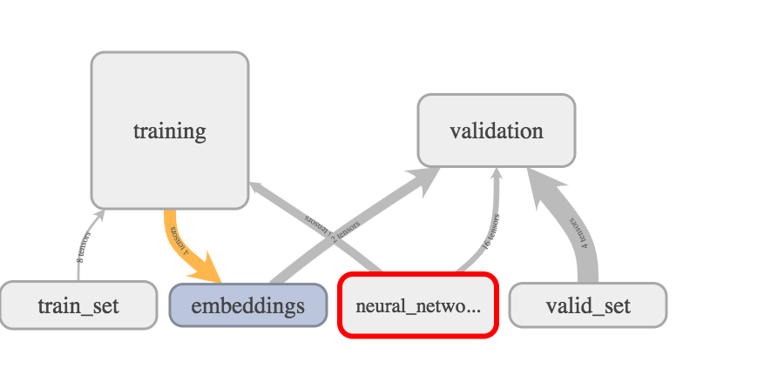
Implementation Steps
Initialize the movie and user embeddings with the results trained in MF model
Initialize the DNN parameter W and b
Calculate Z n
Calculate the prediction
Calculate the loss
Train and validate the model
tensorboard --logdir=path/to/log-directory

